Slide 1

EU`s new fiscal rules and its implications for Finland
Commentary on Zsolt Darvas (Bruegel)
UTAK, 18 Sept 2024
Patrizio Lainà
Chief Economist, STTK

Slide 2
The good
Politically neutral: revenue (taxes) and expenditures symmetrically treated
One single operational indicator
Joint funding with the EU excluded → incentives to increase
Focus on long-term debt sustainability (DSA)
And now the bad…

Slide 3
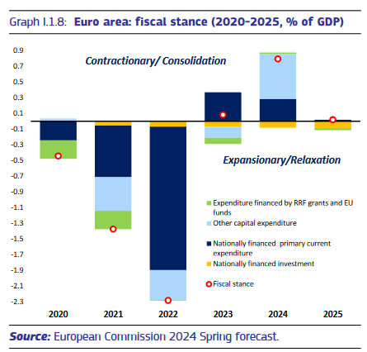
Building on misleading forecasts will be harmful
Forecasts do not include not-yet decided fiscal adjustment! (they are scenarios, not forecasts)
What happens if/when most (large) member states turn to austerity at the same time?

Slide 4
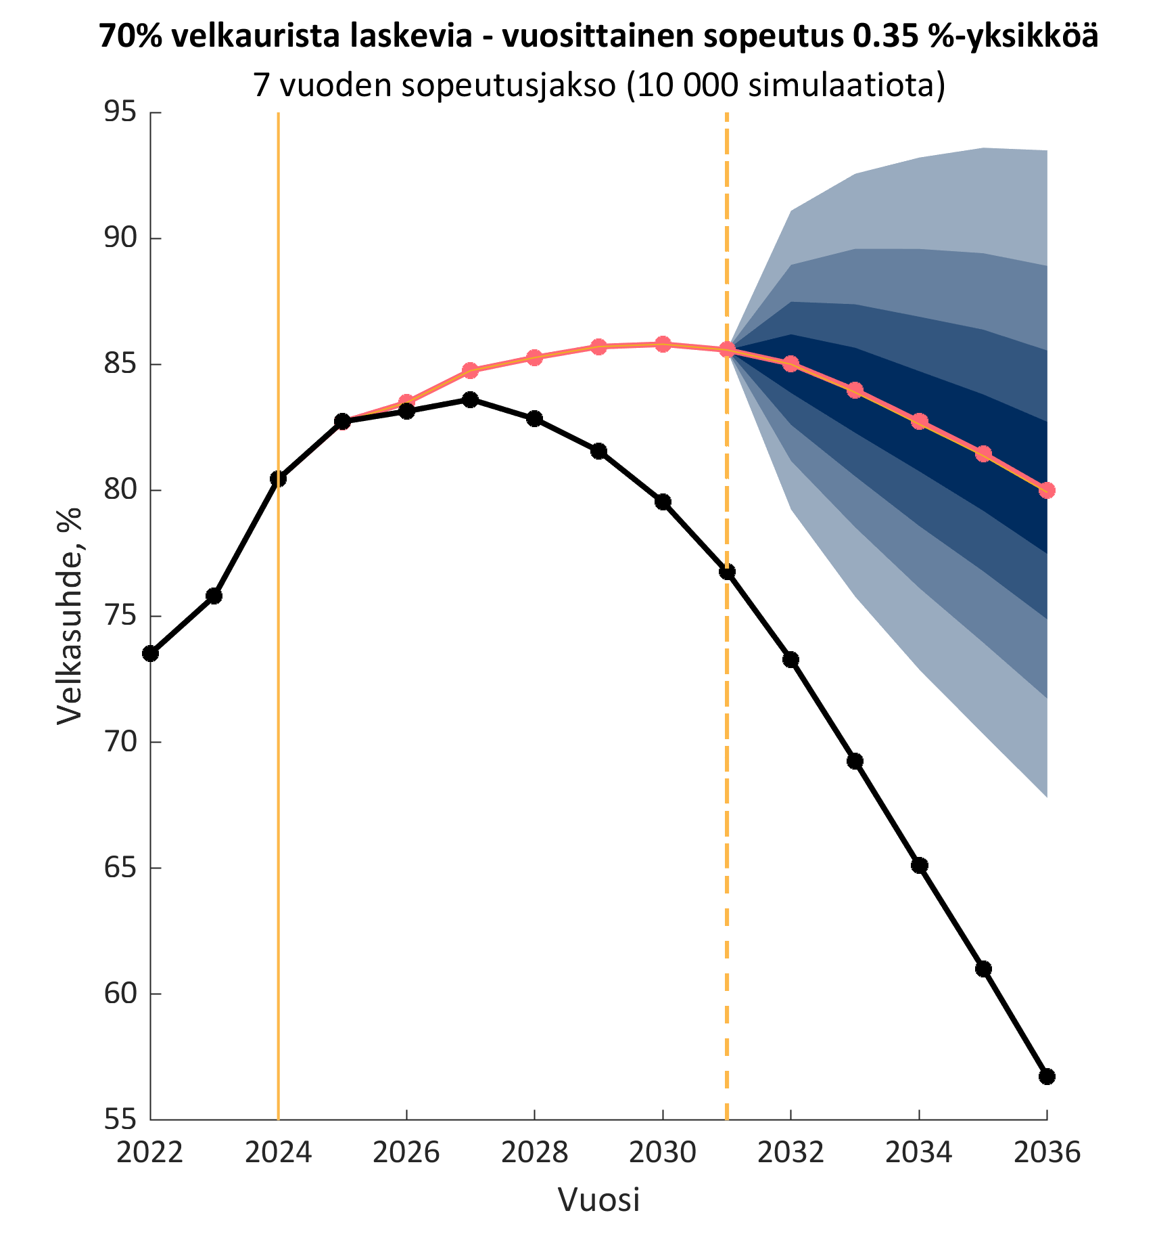
”Safeguards” kick in too early
If debt ratio increasing, fiscal adjustment very high (and counterproductive)
Safeguards double annual fiscal adjustment 0,35 → 0,76 % of GDP
Fiscal adjustment in recession doesn’t decrease debt ratio (IMF)
Who believes in these debt ratio projections?
W/o safeguards
With safeguards
Source: Peetu Keskinen (VTV) with author’s modifications

Slide 5
Fiscal policy modelled unrealistically
National fiscal-structural plans based on misleading forecasts
Fiscal multiplier 1,5 (0,75+0,5+0,25) is decent
But no hysteresis means growth must pick up (slow down) after austerity (stimulus)
  I.e. potential output develops independently
Net expenditure path determined based on this and not corrected (ex post)
Favors austerity on unrealistic grounds
  Euro Crisis ”surprises” and mistakes remade

Slide 6
Finland’s public finances sustainability depends on debt definition (net/gross)
Finland had the least net debt among EU member states
W/o stock-flow adjustment, Finland’s debt ratio decreased significantly (~50 pp in 22 y)
Main reason ”public” pension funds
Assets increasing more than debt → net debt reduced!
However, rules do not care ☹
→ Finland required harshest austerity

Slide 7
Missed opportunities
Public investments highly needed (Draghi report)
  → Investments should have been excluded
What is an investment? Easy answer: look at national accounts
  Harder answer: politically defined
What if not self-financing? Not always relevant
  E.g. green investments can prevent future taxes from collapsing
Current account imbalances key to Euro Crisis
  → CA should have been integrated
Governments don’t control it? Sure, but neither do they control budget deficits
  Sanctioning (e.g. deposit to EIB) CA imbalances (say 3 %) symmetrically creates incentives for sustainable monetary union

Slide 8
A better fiscal rules framework
Abandon ”safeguards”
Focus on net debt
Exclude investments
Integrate current account imbalances

Slide 9


Patrizio Lainà
pääekonomisti
040 583 4432
@PatrizioLaina

